Slide 1

Crop Recommendation Using Multinomial Logistic Regression
A CASE-STUDY BASED PRESENTATION | MACHINE LEARNING | B.TECH | A.Y. 2026-27
TEAM
CH. Sai Vihamsh
2520090090
S. Pardhu Saradhi
2520090043
I. Vikram
2520090118
Department of Computer Science & Information Technology
GUIDE
Dr. Y. Lakshmi Prasanna
Asst. Professor, Dept. of CS&IT
Koneru Lakshmaiah Education Foundation (Deemed to be University), Hyderabad
Notes:
Introduce the team, guide and the project title.

Slide 2



Introduction
Background
Domain overview
Why it is needed
Crop choice decides yield, income and food supply
Each crop needs its own nutrients, temperature, humidity, rainfall and pH
A wrong choice lowers productivity and causes financial loss
Machine learning in agriculture (smart farming)
Supervised multi-class classification
Multinomial Logistic Regression predicts 1 of 22 crops
Farmers often decide from experience or neighbours’ practice
A quick, data-driven recommendation is needed
Class probabilities make the advice easy to explain
Notes:
Crop choice affects yield and income. ML can turn soil and climate data into a recommendation.

Slide 3



Problem Statement
Farmers lack a quick, accurate, data-driven way to decide which of many crops suits their soil and climate.
Existing problem
Limitations / challenges
Who is affected
Crop selection relies on experience and local practice
Soil nutrients and weather are rarely weighed together
Mistakes show up only after the season
Human judgement is subjective and inconsistent
Seven interacting factors are hard to weigh by hand
22 candidate crops make the choice complex
Farmers, especially small and first-time cultivators
Agricultural advisors and extension workers
Consumers, through lower yields and supply
Notes:
Describe the gap: crop selection is subjective and ignores how soil and climate interact.

Slide 4



Motivation
Why we selected this project
Agriculture is a high-impact use of machine learning, and crop recommendation is a clean multi-class problem we could study end to end: data, EDA, model and evaluation.
Real-world need
Farmers need a fast decision-support tool that uses soil nutrients (N, P, K, pH) and climate (temperature, humidity, rainfall) together instead of guesswork.
Research / industry motivation
Precision and smart farming increasingly rely on data-driven recommendations. Logistic regression is a fast, interpretable baseline that also gives class probabilities.
Notes:
Why this project: high-impact use of ML and a clean multi-class problem to study end to end.

Slide 5
Objectives
MAIN OBJECTIVE Build a Multinomial Logistic Regression model that recommends the most suitable crop from seven soil and climate parameters with high accuracy.
1
2
3
4
5
Load, inspect and clean the crop dataset
Explore the data with EDA to see crop-wise conditions
Standardise features and make a stratified 80/20 split
Train the model and tune C by 5-fold cross-validation
Evaluate with accuracy, precision, recall, F1 and confusion matrix
Notes:
Main objective, then five specific objectives that map to the project stages.

Slide 6

Existing System
Farmer experience & local practice
Rough weather / soil-test check
Crop decision
Current approach / technologies
Limitations
Decisions from farmer experience
Local practice and neighbours’ choices
Crop calendars and rules of thumb
Manual soil testing and advisory visits
Subjective and inconsistent
Does not combine all seven factors
No probability or confidence in the advice
Slow and not easily available to every farmer
Notes:
Today crop choice is manual: experience, local practice and rough weather or soil checks.

Slide 7

Proposed System
Subjective decisions
Learns from 2,200 labelled records
Our solution
Factors weighed separately
Uses all 7 factors together in one model
Multinomial Logistic Regression crop recommender
Inputs: N, P, K, temperature, humidity, pH, rainfall
Features standardised, model tuned by cross-validation
Output: recommended crop and probability for each crop
No confidence information
Returns a probability for each crop
Slow, manual advice
Trains in under a second; instant prediction
Notes:
A data-driven model that reads seven inputs and returns a crop with probabilities.

Slide 8
System Architecture
INPUT
PROCESSING
MODEL
OUTPUT
Soil: N, P, K, pH
Climate: temperature, humidity, rainfall
Crop dataset (CSV, 2,200 records)
Data inspection and cleaning
Standardisation (StandardScaler)
Stratified 80/20 train-test split
Multinomial Logistic Regression (softmax, L2)
C tuned by 5-fold CV
Best C = 100
Recommended crop (1 of 22)
Probability for each crop
Accuracy, precision, recall, F1, confusion matrix
Notes:
Input → processing → model → output.

Slide 9
Methodology / Workflow
1
2
3
4
Collect data
Inspect & clean
Explore (EDA)
Standardise
Load the crop CSV with Pandas
Shape, types, nulls, duplicates
Distributions, heatmap, box plots
Zero mean, unit variance
5
6
7
8
Split data
Train model
Tune C
Evaluate
Stratified 80/20 split
Multinomial Logistic Regression
5-fold cross-validation
Metrics, matrix, new prediction
Notes:
Eight steps from raw data to recommendation.

Slide 10






Technology Stack
Programming language
IDE / environment
Framework
Python 3.x
VS Code, Jupyter Notebook, Google Colab
Scikit-learn (Pipeline, GridSearchCV)
Libraries
Database / data
Hardware & OS
NumPy, Pandas, Matplotlib, Seaborn
CSV dataset (MySQL optional)
Intel Core i5+, 8 GB RAM, 10 GB storage; Windows, Linux, macOS
Notes:
Everything runs on a standard Python data-science setup.

Slide 11







System Modules / Components
Data Collection
Data Preprocessing
EDA & Visualisation
ML Module
Load CSV with Pandas
Inspection, scaling, split
Histograms, heatmap, box plots
Multinomial LR in a Pipeline
Tuning
Prediction / Decision
Evaluation
Reporting
GridSearchCV, 5-fold
Crop and probabilities
Accuracy, P, R, F1, matrix
Plots and tables
Notes:
Eight modules make up the pipeline.

Slide 12
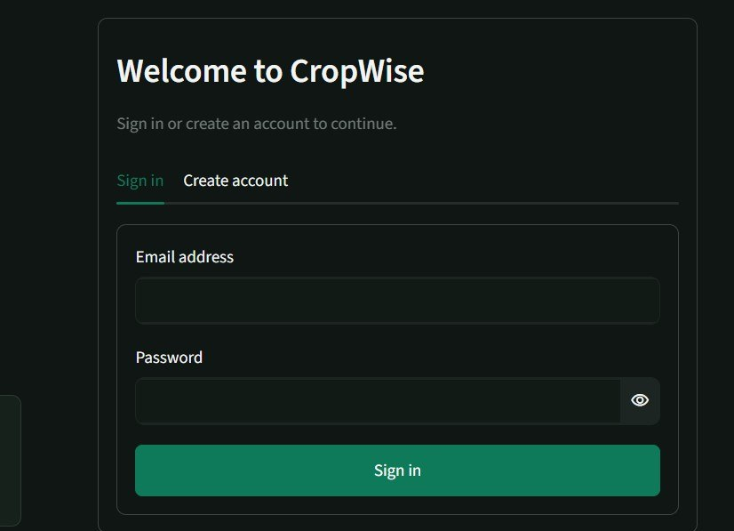

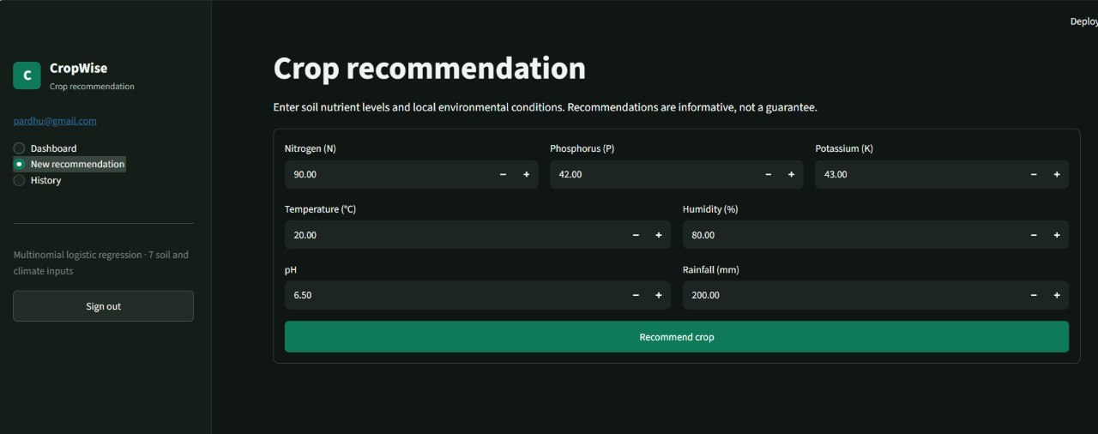
Implementation
Notes:
Scaling and the model live in one Pipeline; C is tuned on the training data only.

Slide 13
Dataset / Input Data
2,200
8
22
0
records
columns (7 inputs + label)
crops, 100 each
missing or duplicate rows
Feature | Range (mean)
N (nitrogen) | 0 – 140 (50.6)
P (phosphorus) | 5 – 145 (53.4)
K (potassium) | 5 – 205 (48.2)
Temperature | 8.8 – 43.7 °C (25.6)
Humidity | 14.3 – 100 % (71.5)
pH | 3.5 – 9.9 (6.5)
Rainfall | 20.2 – 298.6 mm (103.5)
Data preprocessing
No missing values or duplicates to fix
Outliers kept: genuine crop conditions
StandardScaler fitted on training data only
Stratified 80/20 split: 1,760 train, 440 test
Notes:
Crop Recommendation Dataset (Kaggle, CSV): clean and perfectly balanced.

Slide 14
Algorithm / Model
N
Important parameters
P
zₖ = wₖ · x + bₖ
Softmax
L2 regularised
K
22
crop probabilities
Solver | lbfgs (multinomial)
Regularisation | L2, C = 100 (tuned)
Max iterations | 2000
Scaling | StandardScaler
Train-test split | 80/20 stratified (seed 42)
Cross-validation | 5-fold stratified
C values tried | 0.01, 0.1, 1, 10, 100, 1000
Temp
Hum
pH
Rain
7 inputs
Why it was selected
Handles 22 classes in a single model
Gives a probability for every crop
Fast to train and easy to interpret
Notes:
Softmax regression: one linear score per crop, converted to probabilities.

Slide 15
Results: Performance
98.41%
98.52%
98.41%
98.40%
Accuracy
Precision
Recall
F1-score
Key findings
433 of 440 test samples correct
5-fold CV on all data: 98.32% ± 0.18%
Tuning C lifted test accuracy from 97.27% (C = 1) to 98.41%
Train 99.03% vs test 98.41%: no serious overfitting
Notes:
Weighted metrics on the 440-sample test set; C chosen by 5-fold CV on training data.

Slide 16
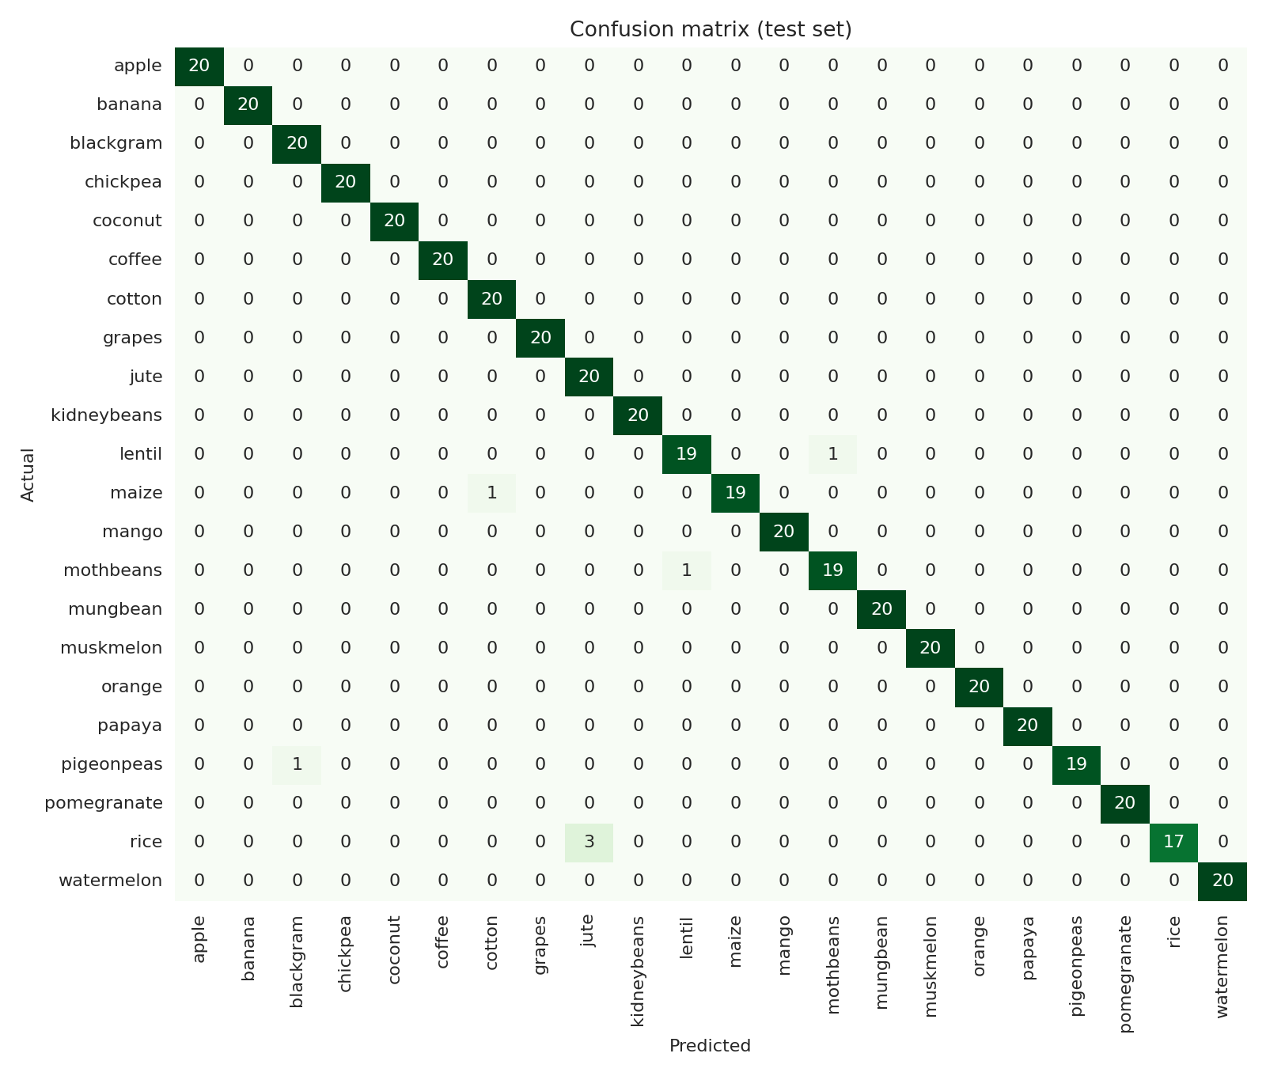
Results: Confusion Matrix
Reading the matrix
17 of 22 crops: all 20 test samples correct
Rice → jute 3 times (both high rainfall and humidity; rice weakest, F1 0.92)
Lentil ↔ moth beans: 1 each way
Pigeon peas → black gram: 1
Maize → cotton: 1
Notes:
Seven errors, all between crops with overlapping growing conditions.

Slide 17
Results: Comparison with Other Methods
Model | Acc. | Prec. | Recall | F1
LR (tuned) | 98.41 | 98.52 | 98.41 | 98.40
Naive Bayes | 99.55 | 99.59 | 99.55 | 99.54
KNN (k=5) | 97.95 | 98.04 | 97.95 | 97.93
SVM (RBF) | 98.41 | 98.56 | 98.41 | 98.40
Decision Tree | 97.95 | 98.06 | 97.95 | 97.94
Random Forest | 99.55 | 99.57 | 99.55 | 99.55
Tuned LR ties SVM and beats KNN and Decision Tree. Naive Bayes and Random Forest score higher (99.55%), but LR is fast, interpretable and gives clear class probabilities.
Axis starts at 95% to make small differences visible.
Weighted precision, recall and F1 on the same 440 test samples.
Notes:
Same split and scaling; only Logistic Regression was tuned.

Slide 18
Demo: Input to Output
1 Load data
2 Input
3 Processing
4 Output
shape: (2200, 8)
N P K temp hum ph rain
90 42 43 20.9 82.0 6.5 203
85 58 41 21.8 80.3 7.0 227
60 55 44 23.0 82.3 7.8 264
label: rice, rice, rice
N = 90
P = 42
K = 43
temperature = 20.9 °C
humidity = 82.0 %
pH = 6.5
rainfall = 203.0 mm
StandardScaler
→ zero mean, unit variance
Linear scores zₖ for 22 crops
Softmax → probabilities
Pick highest probability
Recommended crop:
RICE
rice 92.7 %
jute 7.3 %
maize 0.0 %
A web interface for farmers is planned as future scope.
Notes:
Console-style walkthrough of one prediction; the same code runs in the project notebook.

Slide 19

Advantages
Fast and lightweight
Aspect | Existing | Proposed
Basis | Experience | Data and ML
Factors used | A few | All 7 together
Output | A guess | Crop + probability
Speed | Slow, manual | Instant
Accuracy | Not measured | 98.41% on test
High accuracy: 98.41%
Probability for each crop
Interpretable coefficients
Notes:
Benefits of the system and how it improves on the manual approach.

Slide 20



Applications
Farm-level crop planning
Agricultural advisory
Choose a crop before each season from soil and weather data
Support extension workers and soil-testing labs
Agri-tech platforms
Education and research
Embed in smart-farming apps and services
Teaching example of multi-class classification
TARGET USERS Farmers • Agronomists • Agri-tech companies • Students and researchers
Notes:
Where the recommender can be used and by whom.

Slide 21

Limitations
Current limitations
Dataset / technical constraints
Linear model: cannot capture complex non-linear interactions (rice is confused with jute)
Only 7 inputs: no soil type, season, location, irrigation or market price
Advisory only: verify against local conditions
Curated, clean, balanced data (100 per crop); real field data is noisier
One climate value per record: no seasonal variation
Naive Bayes and Random Forest scored higher here (99.55% vs 98.41%)
Notes:
Honest boundaries of the current work.

Slide 22


Future Scope
Possible improvements
Additional features
Deployment / scaling
Compare Random Forest, SVM, XGBoost, neural networks
Automated hyperparameter search
Ensemble of models
Soil type, season and location
Market price and expected yield
Fertiliser advice for the chosen crop
Web or mobile app with an input form
API with live weather feed
Regional field datasets
Notes:
Improve the model, widen the inputs, then deploy.

Slide 23
Conclusion
Achieved
Key outcome
Overall contribution
A crop recommender using Multinomial Logistic Regression on 2,200 records covering 22 crops.
98.41% test accuracy and 98.32% cross-validated accuracy; only 7 of 440 test errors.
A fast, interpretable ML baseline that supports data-driven crop decisions.
Thank you | Questions?
Notes:
Summarise achievement, outcome and contribution. Invite questions.

